Slide 1

May 2018
Bangalore
Probablity

Slide 2

Probablity Vs Statistics
Probability – Predict the likelihood of a future event
Statistics – Analyze the past events
Probability – What will happen in a given ideal world?
Statistics – How ideal is the world?

Slide 3
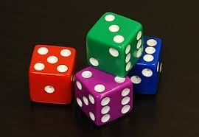
Assigning Probabilities
Classical Method – A priori or Theoretical Probability can be determined prior to conducting any experiment.
𝑃 (𝐸) = # 𝑜𝑓 𝑜𝑢𝑡𝑐𝑜𝑚𝑒𝑠 𝑖𝑛 𝑤ℎ𝑖𝑐ℎ 𝑡ℎ𝑒 𝑒𝑣𝑒𝑛𝑡 𝑜𝑐𝑐𝑢𝑟𝑠
𝑡𝑜𝑡𝑎𝑙 𝑝𝑜𝑠𝑠𝑖𝑏𝑙𝑒 # 𝑜𝑓 𝑜𝑢𝑡𝑐𝑜𝑚𝑒𝑠
Example: Tossing of a fair die

Slide 4
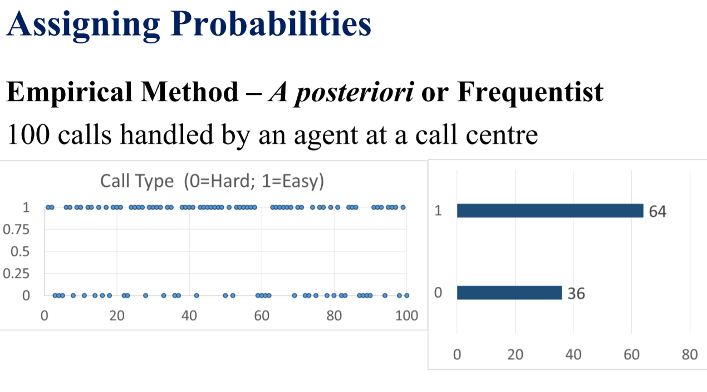

Slide 5
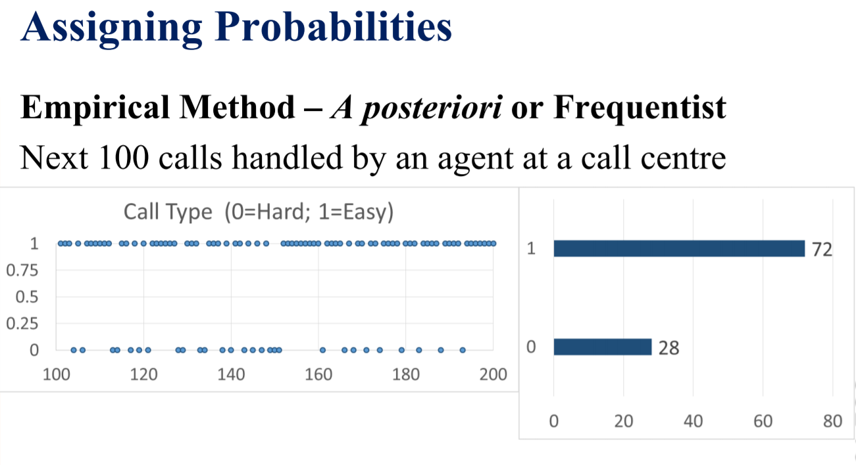

Slide 6
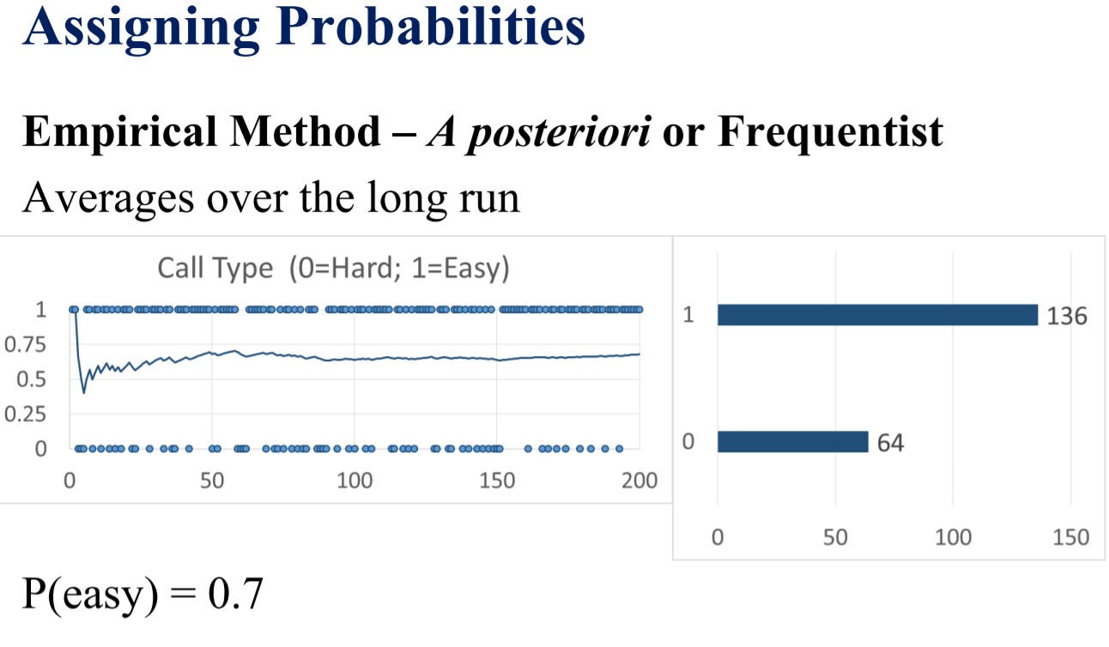

Slide 7
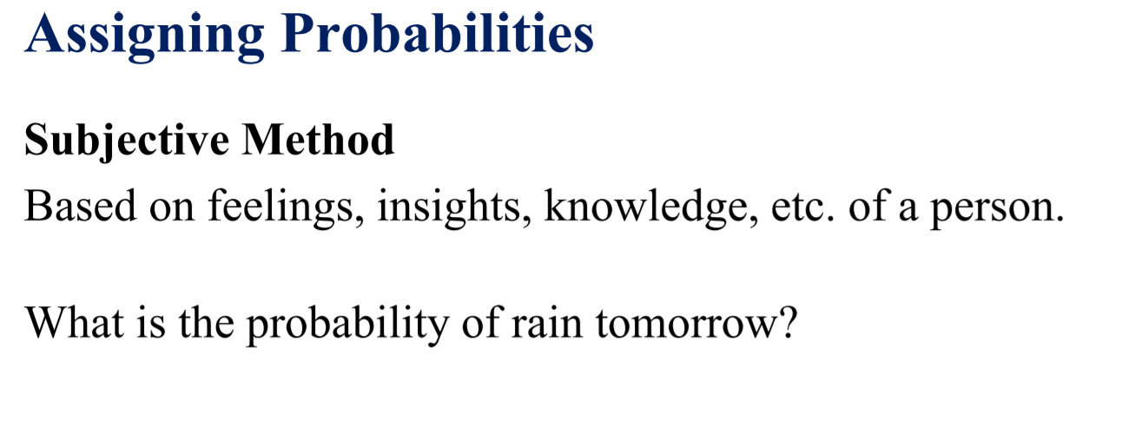
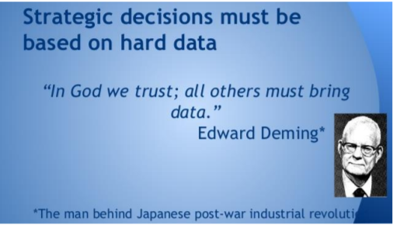

Slide 8
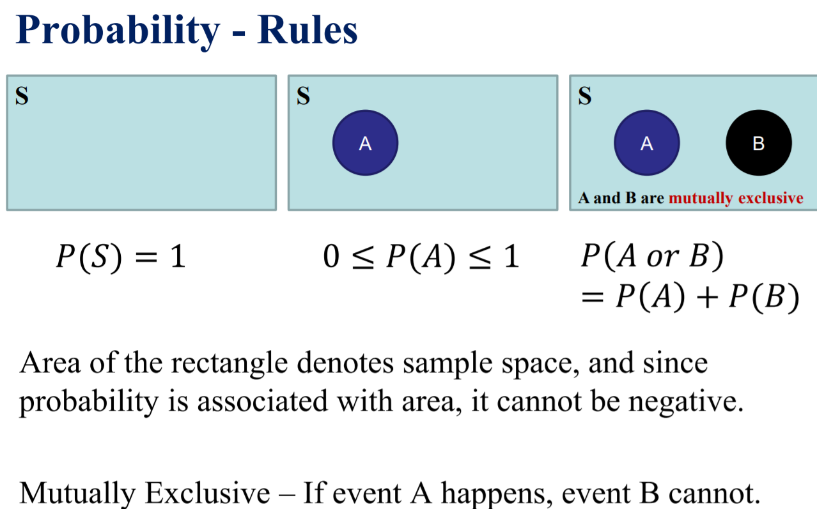

Slide 9
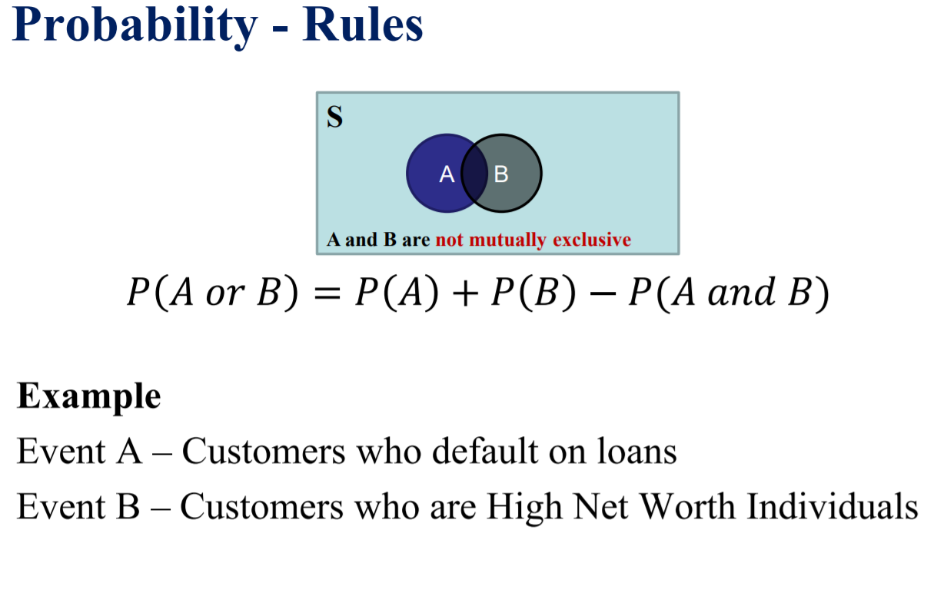

Slide 10
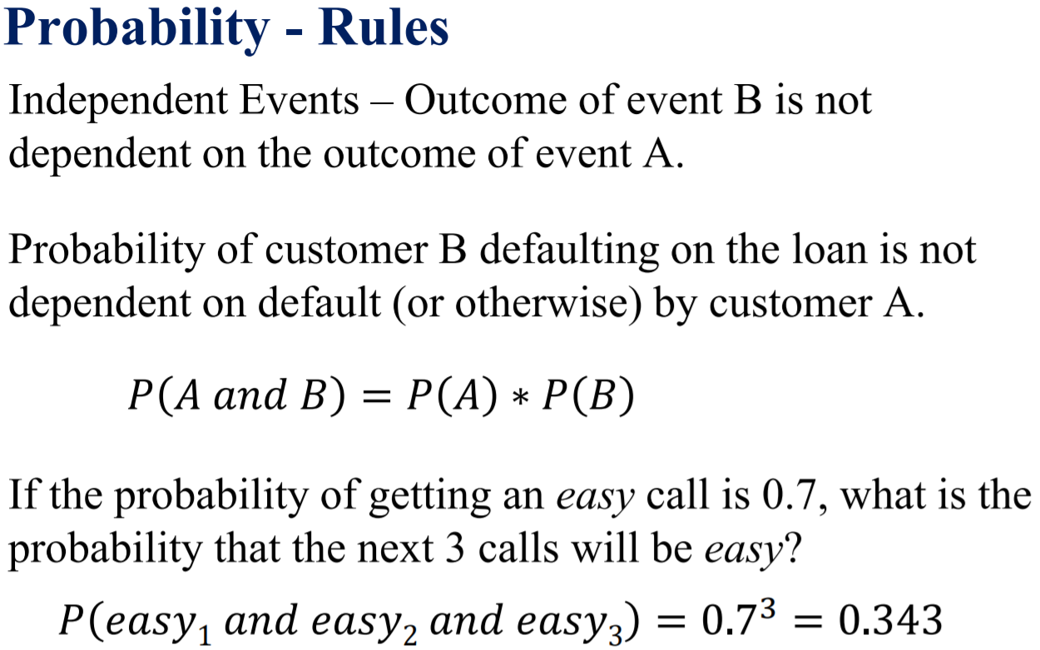

Slide 11
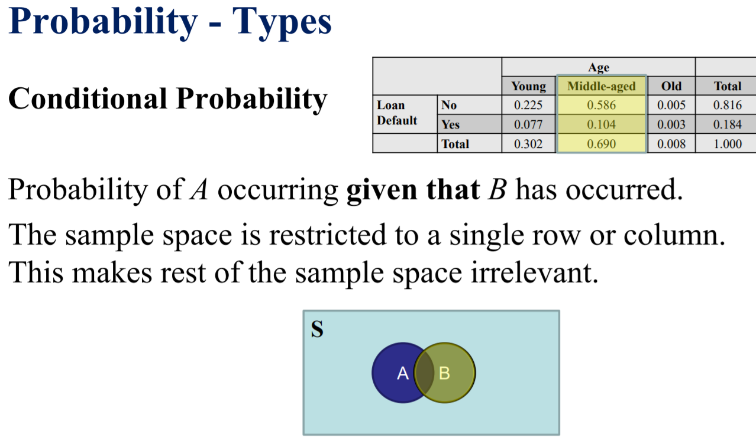

Slide 12
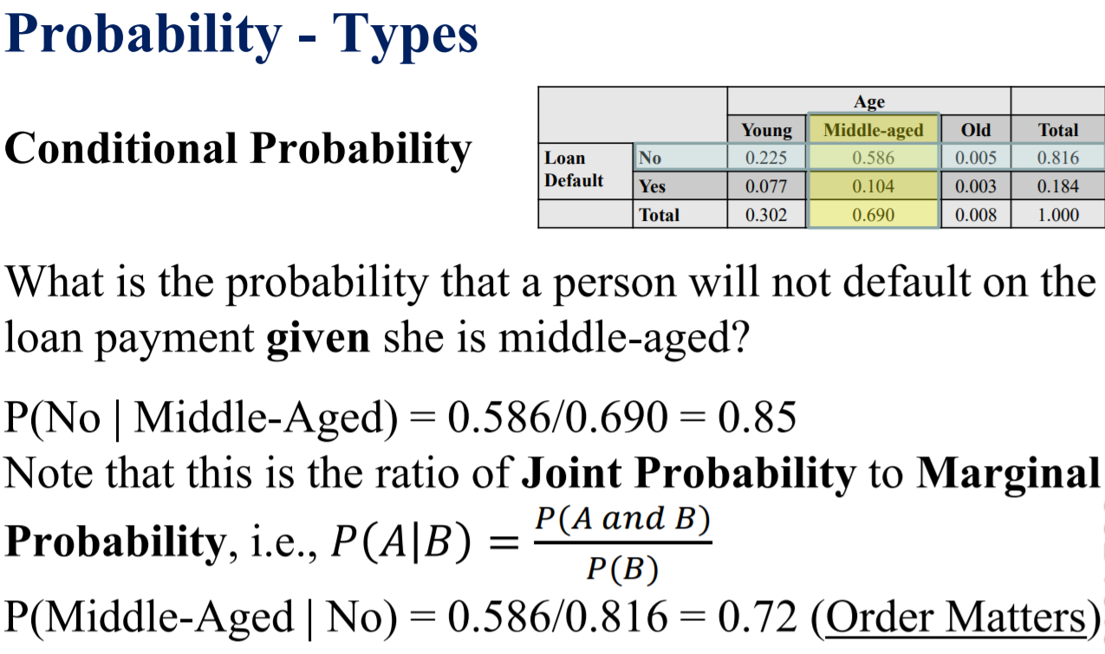

Slide 13
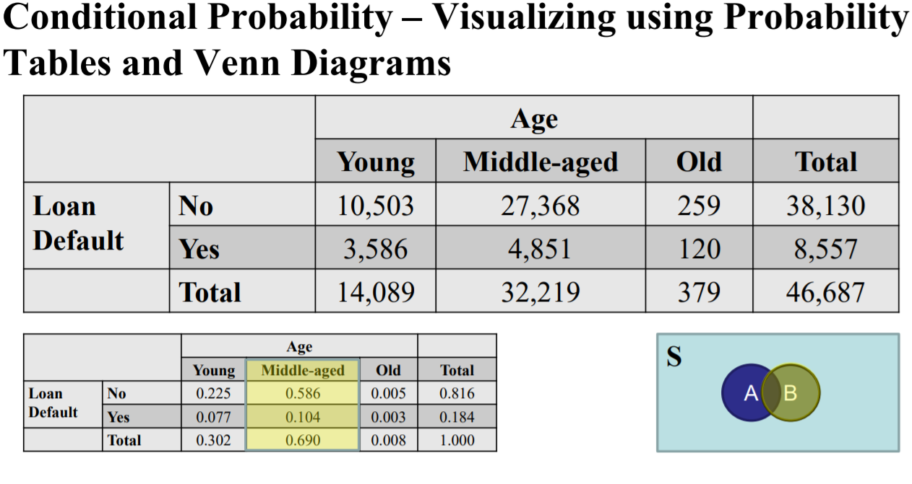

Slide 14
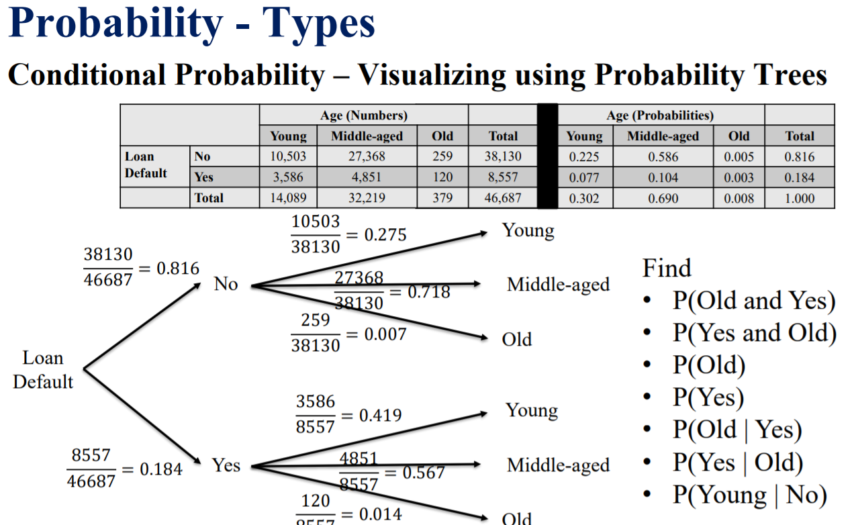

Slide 15
